Slide 1
User Research Summary
Prepared by the Digital Service at Veterans Affairs (DSVA)
Prepared for and presented to the VA Web Brand Consolidation Working Group
October 1, 2018

Slide 2
Outline
We gathered feedback from hundreds of Veterans about our plans for a new va.gov experience.
Study 1 – “Others” Resources Card Sort
Study 2 – Benefit Lifecycle Card Sort
Study 3 – Homepage Wireframe Tests
Study 4 – Navigation Tree Tests
Study 5 – Preview.va.gov Usability Test 1
Study 6 – Preview.va.gov Non-VA Vets
Study 7 – Preview.va.gov Usability Test 2
Study 8 – Preview.va.gov Authenticated Test

Slide 3
Study 7 – Preview.va.gov Usability Test 2

Slide 4
Our goal was to test the full Preview site with Veterans
Study 7 – Preview.va.gov Usability Test 2
In-person user research at the Durham VAMC
Spoke with 18 Veterans of varying ages and races
7 used the mobile site, 11 saw the desktop site
Used the live preview.va.gov website
Took a task-based approach to get feedback on the homepage, Veterans Crisis Line, Veteran images, login experience, and new left-navigation

Slide 5
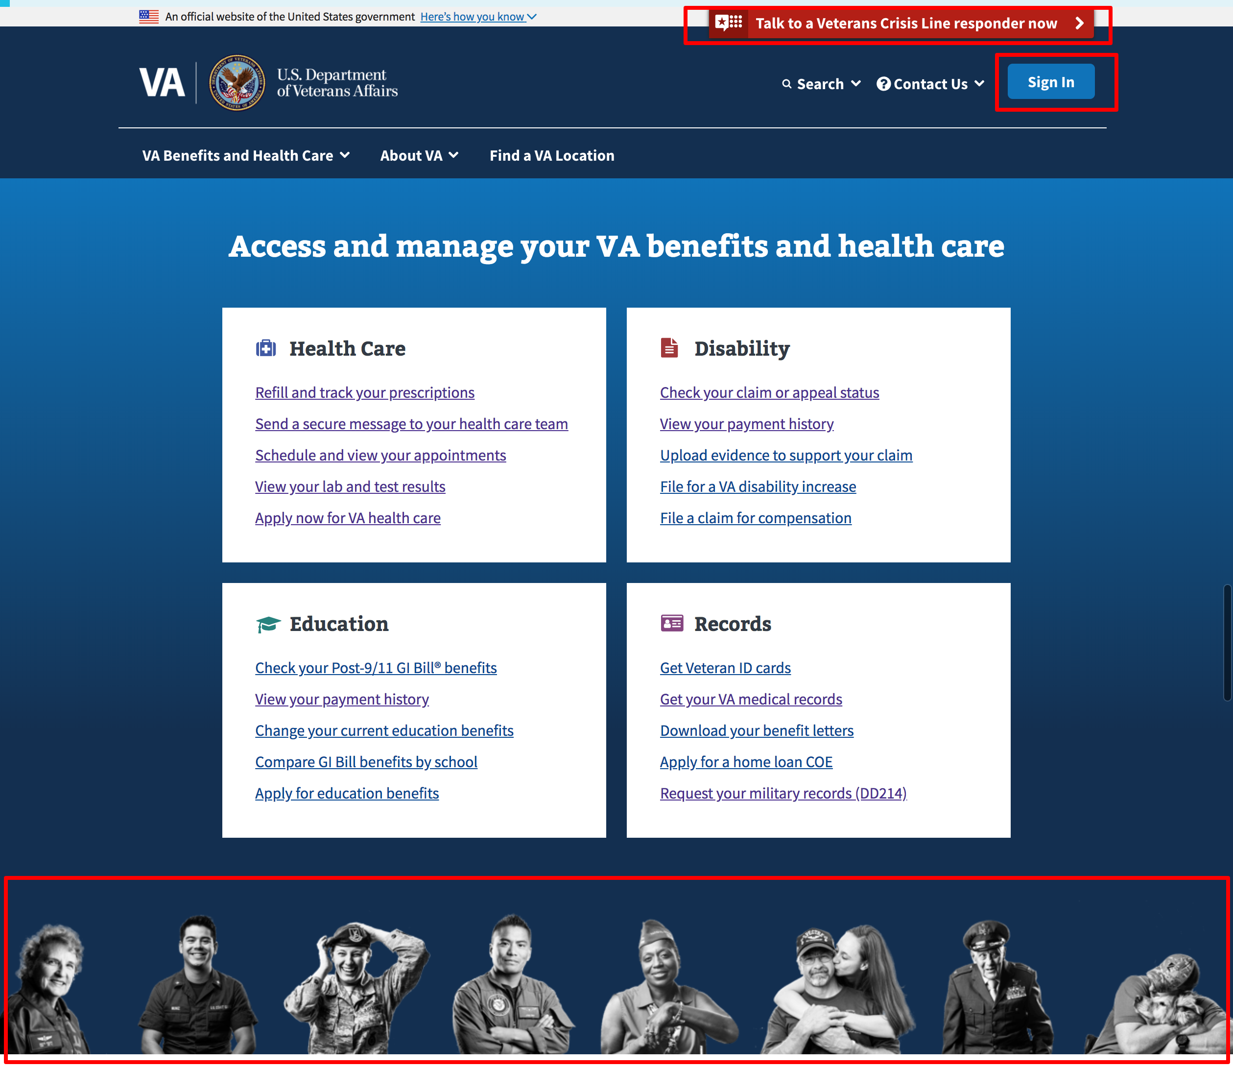
Preview.va.gov Homepage
Study 7 – Preview.va.gov Usability Test 2
On the homepage we focused on a few outstanding questions around:
Veteran’s Crisis Line
Veteran Images
Sign-in

Slide 6
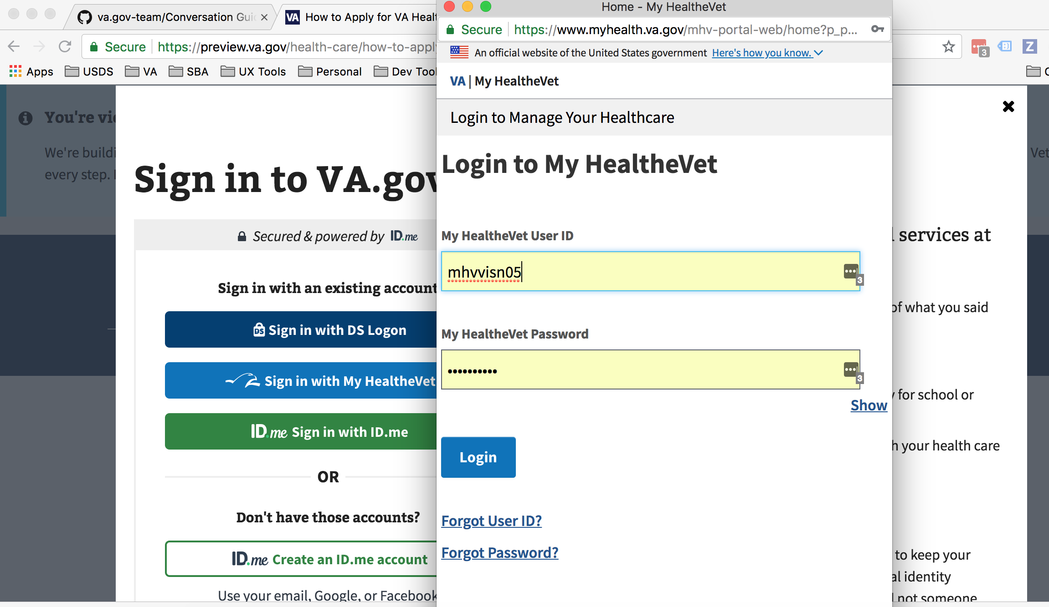
Login Experience
Study 7 – Preview.va.gov Usability Test 2
Watched users work through the sign-in flow for the first time:
Find the login button
Convert MHV account to ID.me
Access authenticated tools

Slide 7
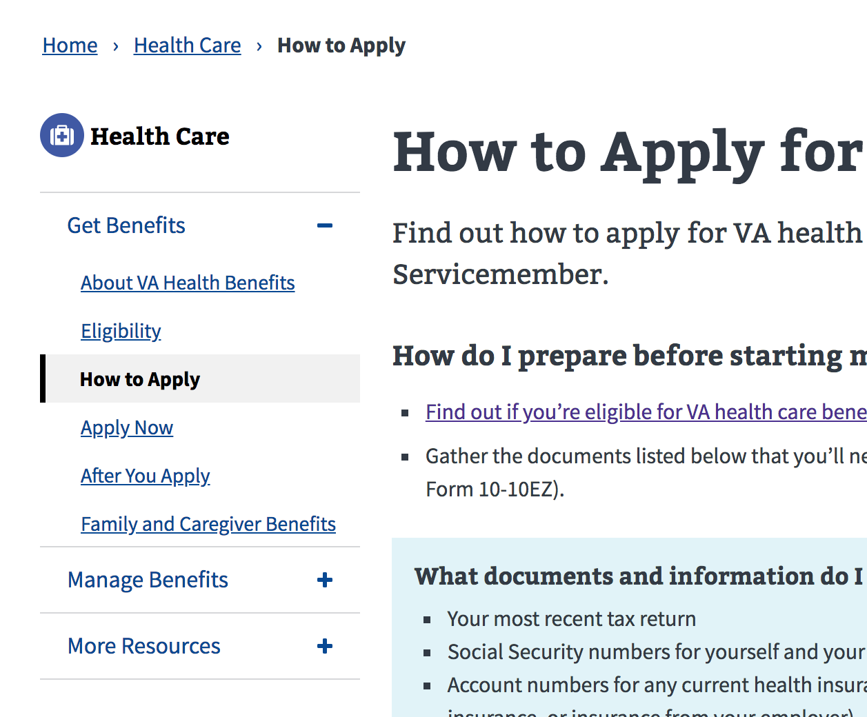
Updated components
Study 7 – Preview.va.gov Usability Test 2
Focused on testing other recently re-designed elements like the content page left navigation

Slide 8
Veteran Quotes for Preview
Study 7 – Preview.va.gov Usability Test 2
"It's a very useful source. Instead of calling a 1-800 number and waiting and waiting and waiting, you can get your payment info, your health care history. It's a very useful tool.” – DP4
"This is a one stop shop, right? One source login for everything, so you don't have to remember all the passwords.” – DP10
“They can go there and take care of things and VA will take care of them as opposed to coming up here [VAMC] and standing in line, they can do as much from home, that would help a lot of guys.” – MP1
“Oh night and day. You had a website and it wasn't as user friendly… There is so much more you can do with it and I believe it will save everybody time and money and help veterans.” – MP6

Slide 9
Veterans Crisis Line Quotes
Study 7 – Preview.va.gov Usability Test 2
"Then I would look for something that says help or crisis.” – DP8
“If you need help at 3am and you're depressed you call this number.” – DP8
"If a guy needs some help, you've got somebody to talk to." – DP9
“We're available 24/7.” – DP10
“It means that I would think that I had a friend that called me a lot who committed suicide that I would prefer to go this route to get help. That's just one example.” – MP6
“This is actually pretty easy. Its all touch you can text, start a confidential chat or even call.” – MP7

Slide 10
Veteran Images on Homepage Quotes
Study 7 – Preview.va.gov Usability Test 2
“It's fine. Showing the different retired guys. But the different branches.” – DP2
"It's got all the branches -- that's pretty cool.” – DP3
“Think it's fantastic. Represents all kinds of different people. Don't see anything offensive about it.” – DP5
“Don't see any marines there. You got Navy Coast guard. Air Force. WWII Army Air Corp. Don't see any marines.” – DP10
“I think its pretty nice. Different veterans that come from different walks of life.” – MP1
“Some people look like they are officially in service and some look like they are spouses. Being a veteran I like seeing them.” – MP7

Slide 11
Between day 1 and day 2 of this study two key usability issues were resolved
Study 7 – Preview.va.gov Usability Test 2
The left navigation component on the content pages was not displaying the updated version – FIXED
Single sign-on to MHV was not functioning – FIXED

Slide 12
We learned a lot about the Veteran Experience
Study 7 – Preview.va.gov Usability Test 2
Veterans are generally returning to the homepage to accomplish tasks after being logged-in, not the dashboard
On MHV, users are able to find the most common tasks
Several Veterans were hesitant to provide their email address and phone number when converting MHV credentials to ID.me
Most Veterans did not find the VCL through the top banner, they either noticed the button or the footer link

Slide 13
We learned a lot about the Veteran Experience
Study 7 – Preview.va.gov Usability Test 2
Veterans had mixed feedback about the “Contact Us” information on the hub pages
The new left navigation corrects the usability issues found in Study 5
Veterans were not confused by the multiple sign-in options (MHV, DS Logon, ID.me)
Open in new tab function failing from the tool landing pages, either because the new tab to MHV/eBN doesn’t open or it gets blocked

Slide 14
Potential design solutions and discussions
Study 7 – Preview.va.gov Usability Test 2
The single sign-on issues with MHV and the new tab usability issues must be fixed before launch
Split the contact us section into two sections - phone numbers and social media links
Keep the VCL copy the same do not rely solely on the banner to drive users to that information
Longer-term the flow to convert an MHV account to ID.me account should be simplified

Slide 15
What Now?
Study 7 – Preview.va.gov Usability Test 2
We have a few critical updates to make and another round of testing coming up next week. We need to focus on fixing major usability issues prior to launch and generating a backlog for post-launch.

Slide 16
Thank you!
Contact Jeff Barnes with questions:
jeffrey.barnes4@va.gov

